Slide 1


Slide 2
SAKAL-CIRCULATION
BACK GROUND
GOAL
CURRENT SCENARIO
PRINT ORDER AND REVENUE
ABC & IRS
COMPETITORS
STRATEGY

Slide 3
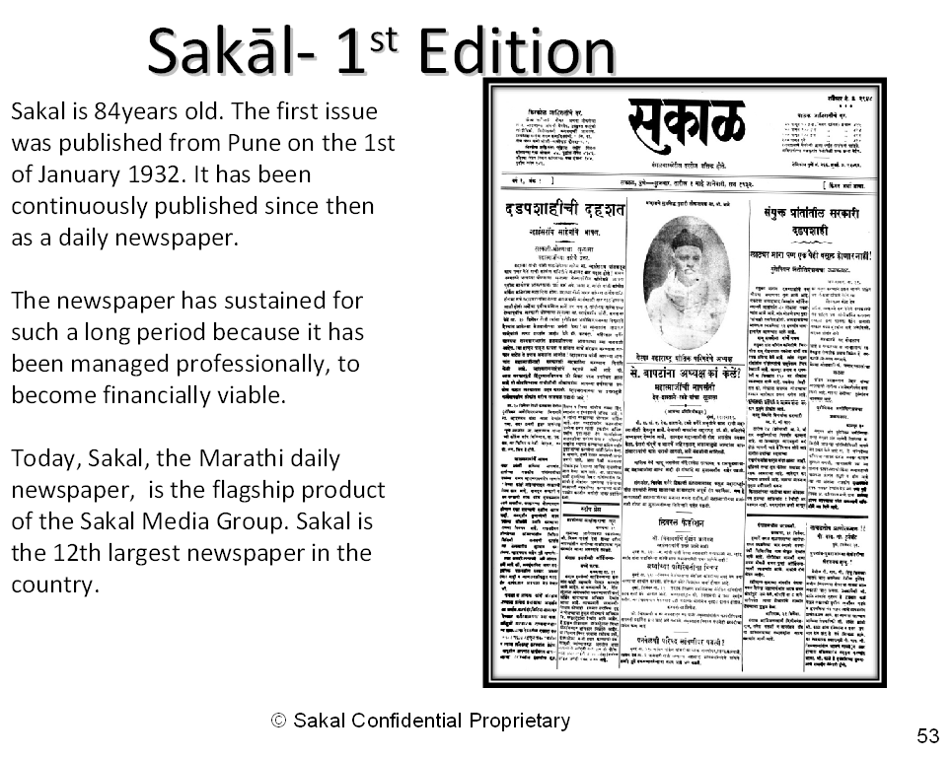

Slide 4
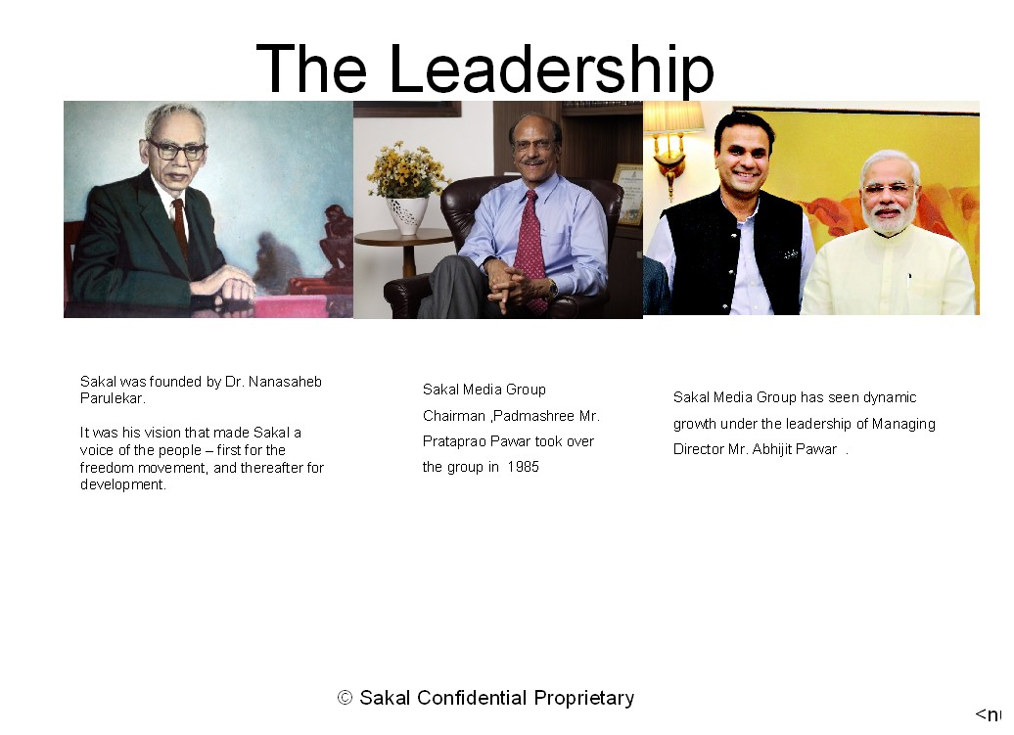

Slide 5
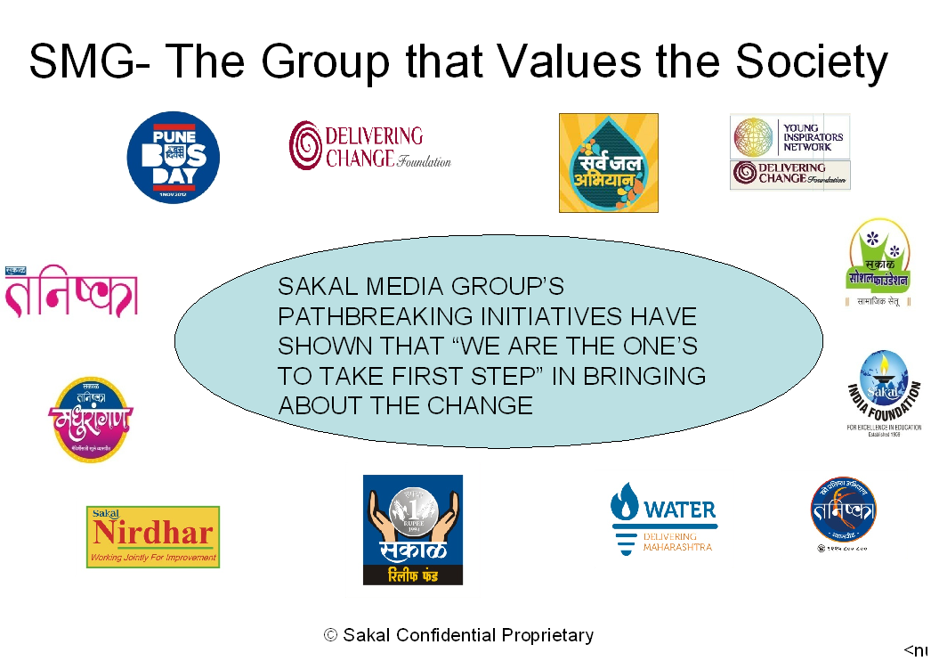

Slide 6
Goal : 2016-17
To increase the base copies at the grass root level with no discount.
To connect with readers to subscribe Sakal.
To make sure that the competitors do not get an easy entry in the house hold of Sakal

Slide 7
CURRENT SCENARIO

Slide 8
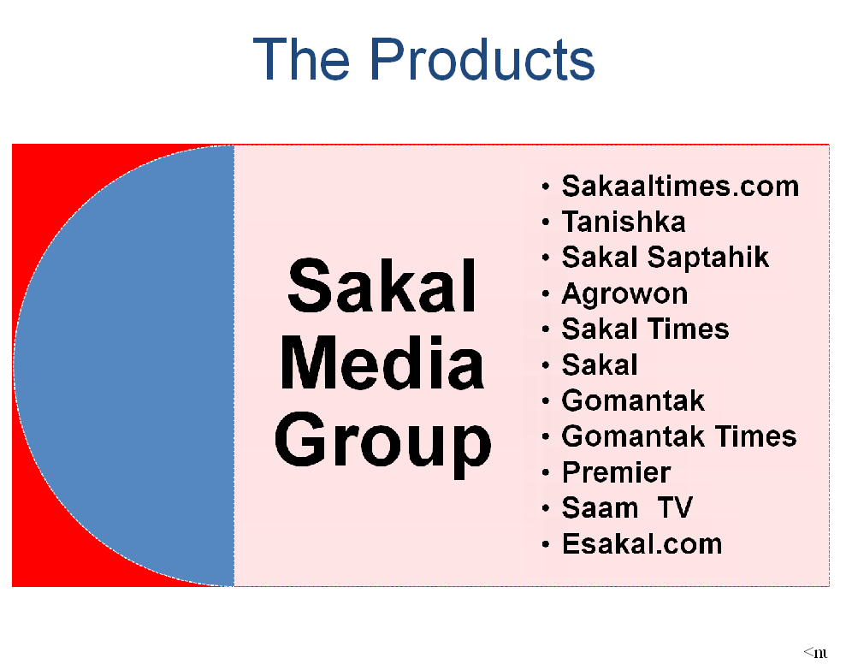
Sakal

Slide 9
Print order comparison at a glance 2014-15 and 2015-16
Publications | Print order 14-15 | Print order 15-16 | Compared to last year achievement in %
Daily Sakal | 1,385,478 | 1,393,898 | 100.61
Agrowon | 112,213 | 113,180 | 100.86
Sakal Times | 24,820 | 23,963 | 96.55
Saptahik Sakal | 27,249 | 28,654 | 105.16
Tanishka | 35,689 | 30,804 | 86.31
Premier | 8,264 | 7,894 | 95.52
 | 1593713 | 1598393 | 100.29
Gomantak | 19,289 | 20,902 | 108.36
Gomantak Times | 3,461 | 3,428 | 99.05
 | 22750 | 24330 | 106.95

Slide 10
Revenue comparison at a glance 2014-15 and 2015-16
Publication | Revenue 2014 - 2015 | Revenue 2015 - 2016 | Compared to last year achievement %
Daily Sakal | 12949.12 | 13475.24 | 104.06
Agrowon | 870.62 | 884.31 | 101.57
Sakal Times | 144.75 | 165.73 | 114.49
Saptahik Sakal | 182.00 | 164.83 | 90.57
Tanishka | 80.27 | 69.22 | 86.23
Premier | 13.68 | 14.52 | 106.14
 | 14240.44 | 14773.85 | 103.75
Gomantak | 206.24 | 226.39 | 109.77
Gomantak Times | 19.23 | 18.94 | 98.49
 | 225.47 | 245.33 | 108.81
 | 14,465.91 | 15,019.18 | 103.82

Slide 11
Sakal Publication revenue March 2015 to April 2016
Publications | Target Revenue | Actual Revenue | Achievement in %
Daily Sakal | 13617.19 | 13475.24 | 98.96
Agrowon | 1067.92 | 884.31 | 82.81
Sakal Times | 189.90 | 165.73 | 87.27
Saptahik Sakal | 197.52 | 164.83 | 83.45
Tanishka | 81.00 | 69.22 | 85.46
Premier | 12.24 | 14.52 | 118.63
 | 15165.77 | 14773.85 | 97.42
Gomantak | 215.51 | 226.39 | 105.05
Gomantak Times | 49.98 | 18.94 | 37.90
 | 230.37 | 245.33 | 106.49
 | 15,396.14 | 15,019.18 | 97.55

Slide 12
Print order Target and Actual
Publication | SAKAL PUBLICATION PRINT ORDER
 | Target P.O. 2015-16 | Actual P.O.2015-16 | Achievement %
Daily Sakal | 1449078 | 1,393,898 | 96.19
Agrowon | 142419 | 113,180 | 79.47
Sakal Times | 25120 | 23,963 | 95.39
Saptahik Sakal | 33491 | 28,654 | 85.56
Tanishka | 36,000 | 30,804 | 85.57
Premier | 8000 | 7,894 | 98.68
 | 1694107 | 1598393 | 94.35
Gomantak | 21047 | 20,902 | 99.31
Gomantak Times | 5830 | 3,428 | 58.80
 | 26877 | 24330 | 90.52

Slide 13
ABC COMPARATIVE FIGURES
UNIT | JAN - JUN 2014 | JUL - DEC 2014 | JAN - JUN 2015 | JUL - DEC 2015 Submited
PUNE | 596710 | 607434 | 563112 | 604324
AURANGABAD | 158921 | 151861 | 124663 | 142175
MUMBAI | 121594 | 133610 | 121001 | 126447
KOLHAPUR | 207768 | 194540 | 200042 | 218258
NASHIK+JALGAON | 94224 | 98935 | 93703 | 101334
SOLAPUR | 29555 | 30183 | 28745 | 30317
NAGPUR | 69612 | 73021 | 68880 | 73208
SATARA | 38710 | 42533 | 40261 | 41838
TOTAL | 1317094 | 1332117 | 1240407 | 1337901
AGROWON | 108911 | 101933 | 100443 | 109173
GOMANTAK | 18221 | 14781 | 15348 | 20471
GOMANTAK TIMES | 2734 | 3143 | 2902 | 3071

Slide 14
Daily Sakal Actual and Projection
Unit | Daily Sakal Actual 2015 to 2016 |  |  | . | Daily Sakal Projection 2016 to 2017
 | Avg.P.O. | Avg. Net Sale | Revenue |  | Avg.P.O. | Avg. Net Sale | Revenue
Aurangabad | 160,881 | 155,138 | 1,387.71 |  | 181,384 | 175,943 | 1,649.31
Jalgaon | 38,564 | 36,554 | 347.95 |  | 37,932 | 36,432 | 300.81
Kolhapur | 226,821 | 220,507 | 2,257.41 |  | 226,042 | 218,390 | 2,171.52
Mumbai | 126,856 | 112,620 | 1,296.66 |  | 129,253 | 124,999 | 1,301.14
Nashik | 64,457 | 61,406 | 606.71 |  | 64,658 | 62,305 | 561.00
Nagpur | 73,991 | 70,013 | 753.38 |  | 98,254 | 95,306 | 954.47
Pune | 630,047 | 617,739 | 6,122.99 |  | 634,975 | 626,377 | 6,143.88
Satara | 41,278 | 40,550 | 435.27 |  | 40,417 | 39,372 | 408.66
Solapur | 31,002 | 29,164 | 267.16 |  | 30,477 | 28,657 | 245.01
Total | 1393898 | 1343691 | 13475.24 |  | 1443392 | 1407781 | 13735.80

Slide 15
Maharashtra readership(IRS) 2013-14
Publications | Readership
 | 2013 Total Readership | 2014 Total Readership | Increase OR Decrease
Sakal | 3702 | 4003 | 301
Lokmat | 5494 | 5789 | 295
Punya Nagari | 2249 | 2398 | 149
Pudhari | 2061 | 2103 | 42
Maharashtra Times | 1643 | 1701 | 58
Divya Marathi | 1210 | 1264 | 54
Loksatta | 1022 | 1083 | 61

Slide 16
Maharashtra readership(IRS) 2013-14
Publications | Age Group
 | 2013 | 2014 | Increase OR Decrease | 2013 | 2014 | Increase OR Decrease
 | 16 to 29 | 16 to 29 |  | 30 to 39 | 30 to 39
Sakal | 1255 | 1406 | 151 | 777 | 867 | 90
Lokmat | 1950 | 2089 | 139 | 1118 | 1185 | 67
Punya Nagari | 899 | 922 | 23 | 378 | 433 | 55
Pudhari | 615 | 692 | 77 | 414 | 485 | 71
Maharashtra Times | 497 | 511 | 14 | 273 | 331 | 58
Divya Marathi | 339 | 359 | 20 | 255 | 283 | 28
Loksatta | 250 | 266 | 16 | 142 | 149 | 7

Slide 17
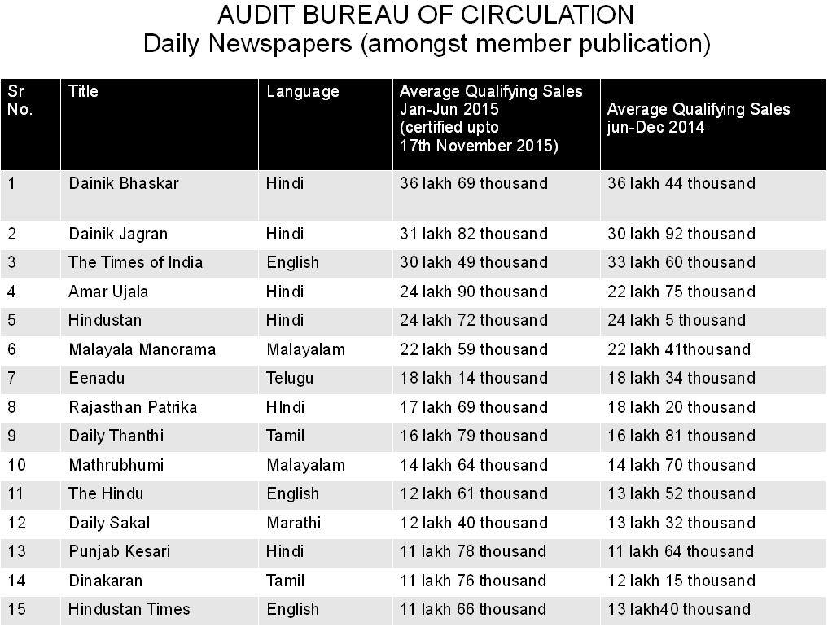

Slide 18
COMPARATIVE CIRCULATION FIGURES AS PER A.B.C. INCOMING CERTIFICATE
Unit | DAINIK SAKAL |  | LOKMAT |  | PUDHARI |  | DAINIK SAKAL Submited
 | JUL - DEC 2014 | JAN - JUN 2015 | JUL - DEC 2014 | JAN - JUN 2015 | JUL - DEC 2014 | JAN - JUN 2015 | JUL - DEC 2015
PUNE + NAGAR | 607434 | 563112 | 177367 | Not Ceritified | 223732 | 215622 | 604324
AURANGABAD | 151861 | 124663 | 287669 | Not Ceritified | N.A | N.A | 142175
MUMBAI | 133610 | 121001 | 139129 | Not Ceritified | 90128 | 97853 | 126447
KOLHAPUR + SATARA | 237073 | 240303 | 95787 | Not Ceritified | 378098 | 379530 | 260096
NASHIK + JALGAON | 98935 | 93675 | 237382 | Not Ceritified | N.A | N.A | 101334
SOLAPUR | 30183 | 28745 | 66087 | Not Ceritified | N.A | N.A | 30317
NAGPUR | 73021 | 68511 | 349477 | Not Ceritified | N.A | N.A | 73208
GOA | N.A | N.A | 28814 | Not Ceritified | 7498 | 7046 | N.A
TOTAL | 1332117 | 1240010 | 1381712 | 0 | 699456 | 700051 | 1337901
 | JUL - DEC 2014 | JAN - JUN 2015 |  | JUL - DEC 2014 | JAN - JUN 2015 |  | GOMANTAK
GOMANTAK | 14781 | 15348 | G.TIMES | 3143 | 2902 |  | 20471

Slide 19
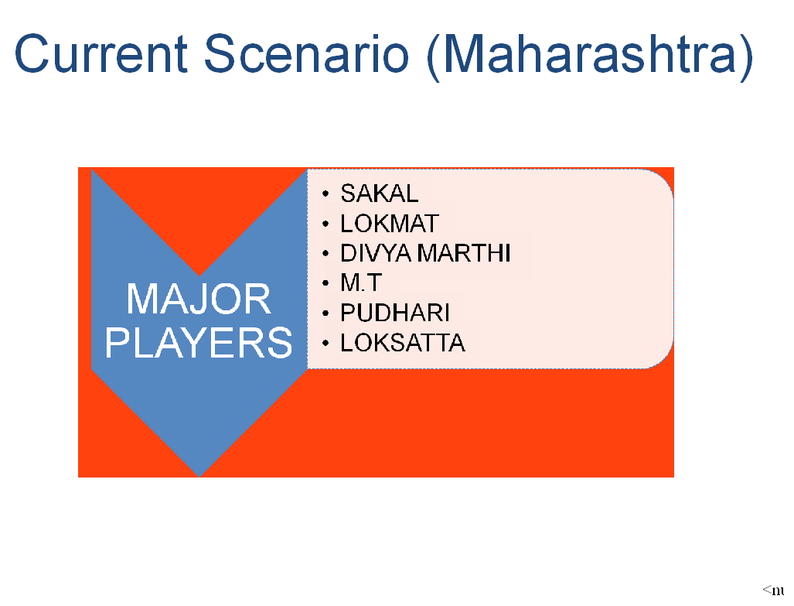

Slide 20
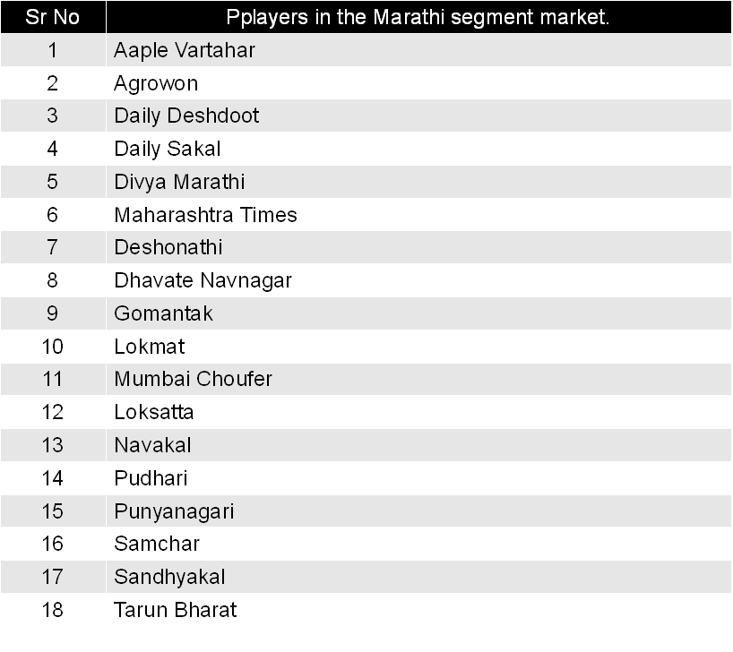

Slide 21
Circulation strategy : 2016-17
Changing scenario :
In last ten years the drastic change

Slide 22
Ten years ago
News paper.
Television
Radio
No smart phone.

Slide 23
The change in last ten years
Options for the customer:
Internet: ( In 90’s it was a space of science fiction and World wide web was in its nascent stage…. today we live in digital times.)
Online
Smart Phone
Tabs
Tv
Print
Radio

Slide 24

THE PRESENT SCENARIO
The reader is attracted with all the hustle and bustle.
The vendor is pampered.
Agents are lured.
Copies are getting dumped.
With manpower shortage vendor finding it difficult to manage.

Slide 25
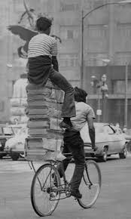
CIRCULATION-REDEFINED

Slide 26
CIRCULATION STRATEGY 2016-17

Slide 27
Pune city- What comes to our mind?
National Defence Academy.
Shaniwar-wadha.
Raja Kelkar Museum.
Aga Khan Palace.
Pataleshwar cave temple.
Osho ashram.
Educational and IT hub.
Film and Television Institute of India.
Malls, hotels, multiplexes .
Happening city

Slide 28
Why Not
SAKAL-CITY

Slide 29
Sakal-Strategy
Sakal booth.
Create awareness about Sakal booth through our newspaper. Its purpose and importance.
Identifying around 15-20 important locations/chowks in Pune city.
Will have Sakal booth monitored by edit and circulation team to interact with the readers.
The idea behind this to make it more easy for the readers to approach us.
Readers share their views, ideas, grievances with the Sakal team at the booth.

Slide 30
Promotional drives
Increasing Network of Agencies and strengthen reporters network in the focused areas.
Stall sales with better visibility.
Society /Locality Connect.
Vachak melawa.
Institutional Promotion & Sales Drives
Being Part of City/ Village events
Door to door campaigns in city.
Sakal Booth.

Slide 31
Sakal activities-2015-16
Few Imp activities:
Full2smart.
Bal mitra chitra kala spardha.
Mi Sarpanch Boltoy
Carrier guidance.
YIN activity development seminar.
Principal meets in schools at the unit level.
Society connect through chairman and secretary.
Vachak Melawa.
Coffee with Sakal.
Happy Neighbhourhood.
Self defence workshop.
Tandurust Bandobast.
Horlicks Sampling.
Sponsored copies.
Increasing copies through bulk sales .

Slide 32
Sakal circulation strategy 16-17
AREA TO BE FOCUSSED:
Pune city.
Aurangabad city, Nanded, Latur, Parbhani and Jalna.
Nagpur city, Amravati, Akola.
Mumbai city, Navi Mumbai &Thane.
Kolhapur city, Ichalkaranaji, Sangli and Belgaum.
Nashik city.
Jalgaon city, Dhule, Nandurbar.
Nagar ctiy.
Solapur city, Barshsi and Pandharpur.
Satara city and Karad.

Slide 33
Strategy 2016-17
Madhurangan members:
More than 70,000 participants. These readers are already half through us as madhurangan members. Madhurangan co-ordinators have a good rapport with them.
Opportunity for us to make them subscribe Sakal at home.
Members of Madhurangan, but not necessarily Sakal subscribers at home.

Slide 34
YIN
We have young inspirator network across all units with more than 9,000 members.
Across the units we have the data available with us. Circulation managers and the team with the support of editorial team will go all out to ensure that the students subscribe to Sakal.
Reading Sakal by this members will ensure us for a better connection among the students down the line.
The above students will be YIN members but may not be subscribing to Sakal on regular basis, hence the efforts.

Slide 35
STRATEGY-NIE-2016-17
NIE:
Across Maharashtra we have more than 21000 students from 246 schools subscribing for NIE copies.
Co-ordination by the editorial support through the school principals, teachers and parents we can ensure more subscribers to read Sakal at home.
21000 students connected with us through NIE, but not necessarily readers of Sakal. Hence the efforts in the above segment.

Slide 36
STRATEGY-SSF-2016-17
Right from its inception, the Sakal Social Foundation (SSF) has been involved in activities contributing to the betterment of society.
Always working in the spirit of ‘social first’, SSF has partnered with other organizations across various initiatives to ensure that the benefit is maximized.
We have more than 150 villages tied up with this activity across Maharashtra, we will use this connect to increase our base copies

Slide 37
STRATEGY-TANISHKA
Emotional, Financial and physical security is the critical need in society in order for women to have a dignified life and fully harness and galvanize their potential.
We have a connect for more than 10000 members, we will try and work out to use this connect/segment in broader prospective to achieve our set goal.

Slide 38
AKOLA 4th April-2016

Slide 39


Slide 40


Slide 41
STRATEGY-AKOLA
Our top priority is Akola and Nanded.
Akola to launch on 4th April 2016 with a print order of 25000 copies.
The circulation team has taken an ambitious target of 50,000 Sakal copies in both the units.
Cover price, appointing new agents and meeting the readers at the root level will be there core area.
Reaching out through campaigners on door to door basis.
Incentives to the vendors on incremental copies.
Awareness through eye catching hoarding.
Awareness through Radio FM.
.l

Slide 42
Akola-promotional activity
Designer umbrellas at the stalls.
Auto with loud speaker.
Auto panels.
Glow sign boards.
Cinema advertisement.
Wall paintings.

Slide 43
Why full2smart activity
More than 20 lakh students across Maharashtra are approached.
Reaching out in various schools creates lot of attentiveness from the students and parents.
Well planned and executed activity.
Huge response from the students.
Opportunity to sample the product for 3months.
No discount on the cover price.
Students who qualify get attractive gifts like laptop, gear cycle, wrist watch, travel bag, tiffin box etc.
In the market before the competitor launches similar activity.
Qualify in ABC working and gives a big boost in net sales.

Slide 44
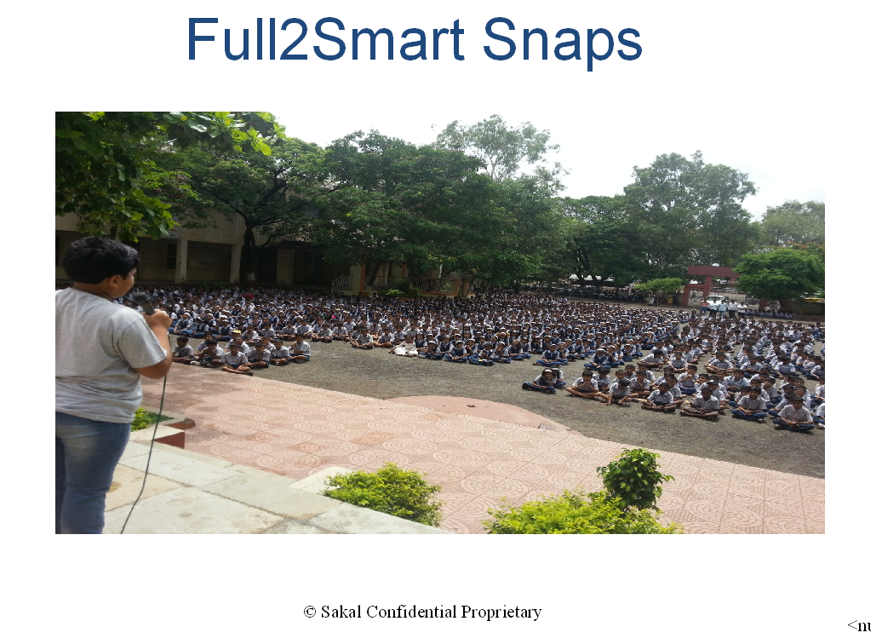

Slide 45
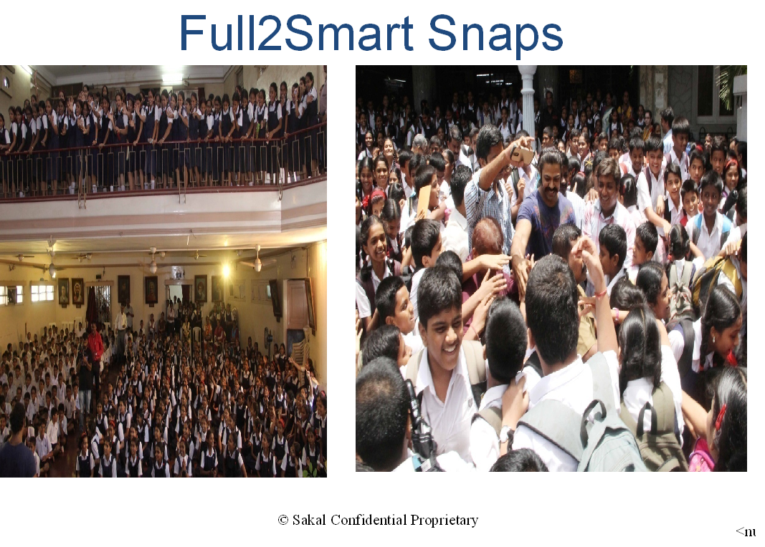

Slide 46
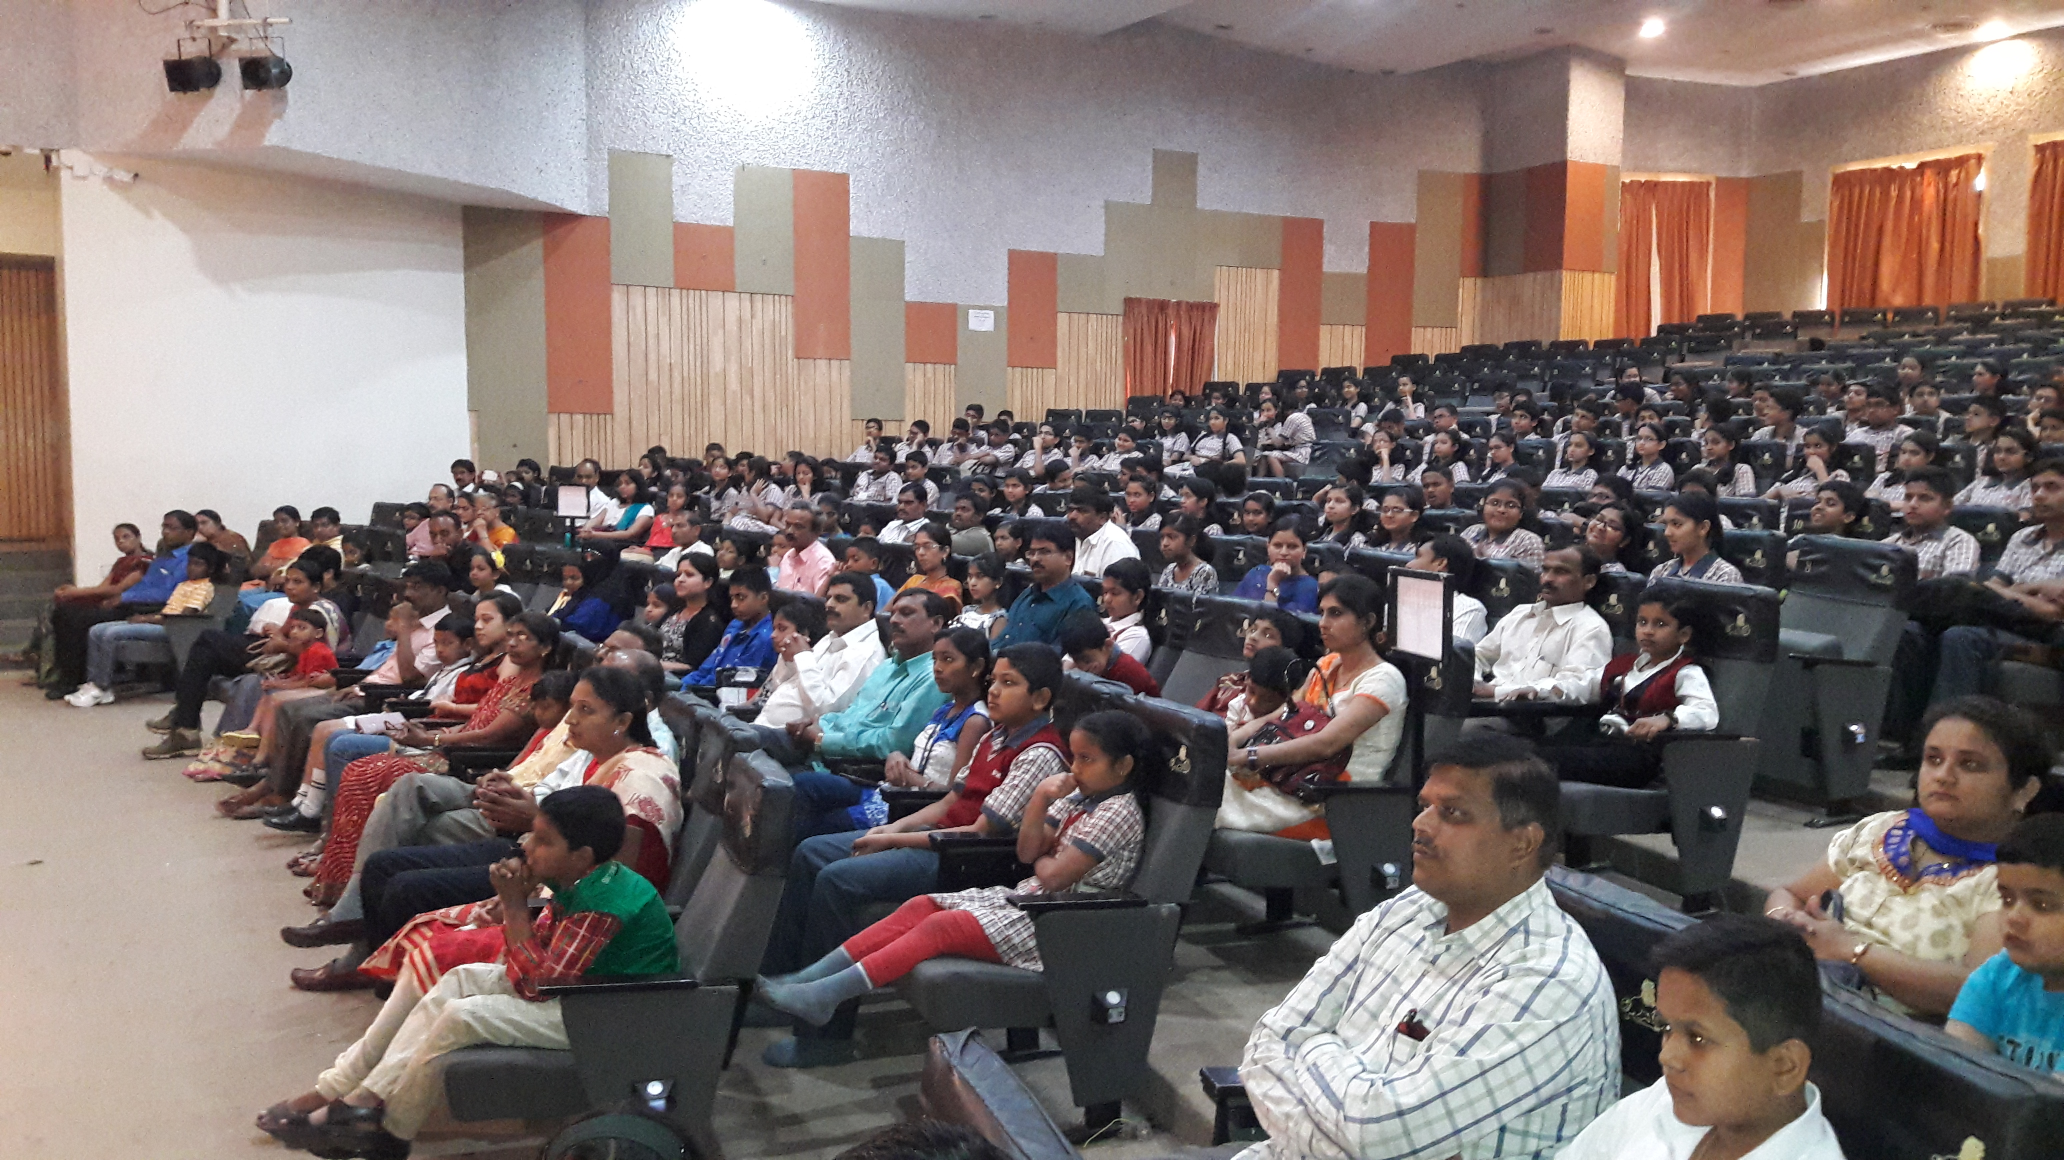

Slide 47
BAL MITRA CHITRA KALA SPARDHA

Slide 48
Bal mitra chitra Kala spardha
One of the rare activity which is been conducted for more than 30 years.
Around 5lakh students participated across Maharashtra.
For the first time we launched the concept of online participation.
Around 1000 students participated through online.
State level prize distribution event held in Pune.
Around 600 centers made available for the students to participate on the same day in Maharashtra and Goa.
Topics given for drawing was to make the students think out of box.

Slide 49
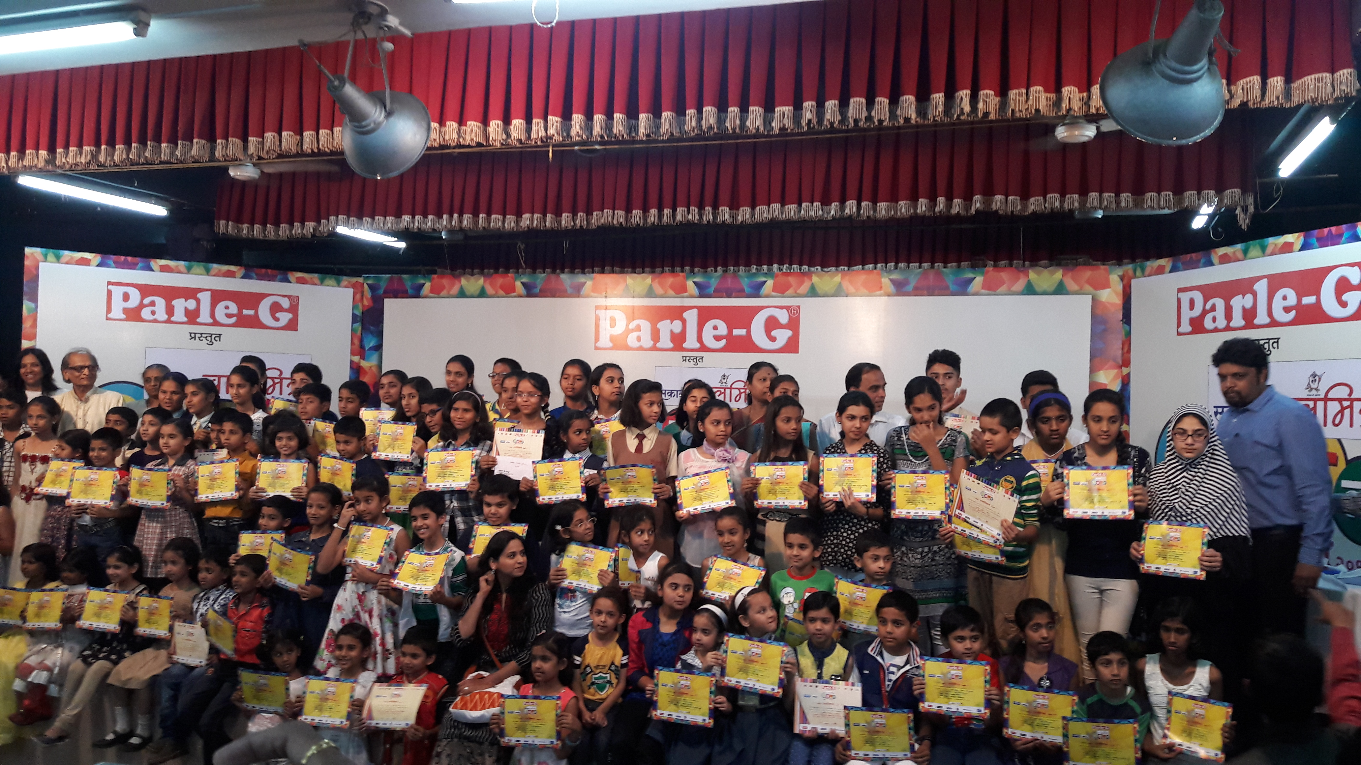

Slide 50
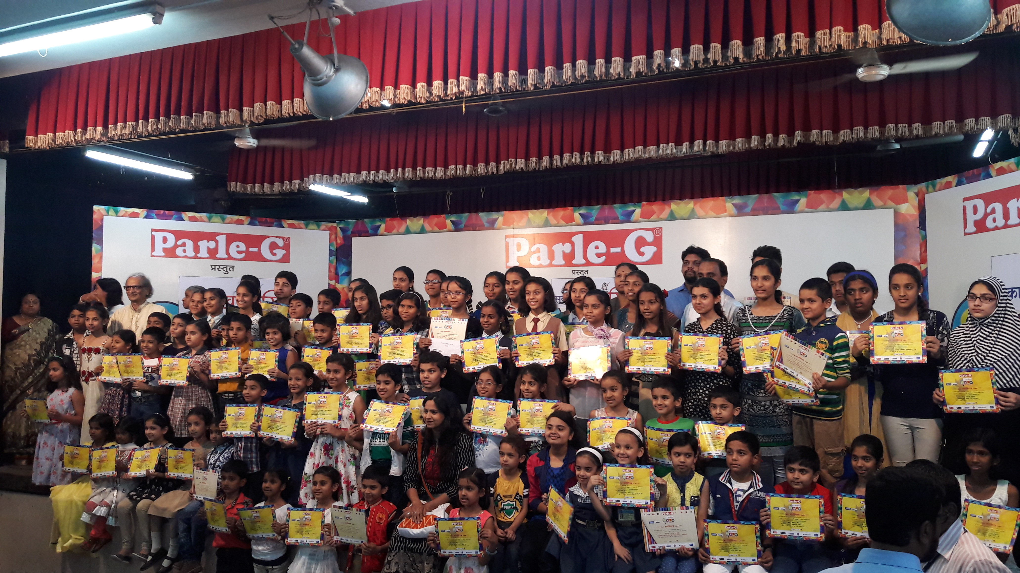

Slide 51


